Slide 1
HABITAT TECHNOLOGY
MODULE IV

Slide 2
Syllabus
Lighting of interior and exterior :- measurement of light - Types of artificial lights – Glare - Munsell system, Photometric measurements, sky component
Acoustics :- Biological and psychological effects – sources - Sound and noise - Noise control.
Town planning :- Principles of town planning - Town growth.
Slum :- Definition – Causes of Slums – Characteristics of Slums – Effect of Slum – Agencies and Methods of Slum clearance.

Slide 3
NATURAL & ARTIFICIAL LIGHTS
Natural light is the light generated naturally.
The most common source of natural light on Earth is the Sun.
We receive natural light throughout our sunlight hours, whether we want it or not. That is, we cannot control the amount, duration and intensity of the natural light.
The light we obtain from Sun covers the entire visible spectrum, with violet at one end and red at the other.
This light is good for our health and is necessary for plants to carry out photosynthesis.
Fire is another source of natural light.

Slide 4
NATURAL & ARTIFICIAL LIGHTS
Artificial light is generated by artificial sources, such as incandescent lamps, compact fluorescent lamps (CFLs), LEDs, etc.
We can control the quality, quantity and duration of this light by controlling a number of factors.
Artificial light is necessary for us to work during hours of low lighting (evening and/or night).
The artificial light does not cover the entire light spectrum and is not too conducive to photosynthesis or health of life forms.
Artificial lights are available in a wide variety of shapes, sizes, colors of light emitted, and levels of brightness.

Slide 5
NATURAL & ARTIFICIAL LIGHTS
While natural light is produced by the sun, artificial light sources can include incandescent bulbs, fluorescent tubes and light-emitting diodes (LEDs).
Natural light, which produces heat and color, comes from the radiation given off by the sun. It is then filtered through the Earth's atmosphere and absorbed by plants.
Artificial light sources can consist of a filament that uses electricity or halogen gas to glow, or an electronic device that emits light. Some artificial lights use gas and electricity to produce light and heat.
Unlike natural sunlight, artificial lighting intensity can be adjusted to serve the needs of individual plants.

Slide 6
Types of artificial lights
Incandescent lighting
Incandescent lighting is produced by light bulbs that give off both heat and light and is a good alternative to natural light.
Because its colour spectrum is closer to natural light than many other light sources, it was traditionally the preferred source for general-purpose illumination.
Contains nitrogen or argon gas
Tungsten filament with lead wires - burns when electricity is passed
Also called as tungsten filament bulb
Advantage - light quality and color are very consistent
Disadvantage - requires lot of energy and faster degradation of filament leading to shorter lifespan
However, incandescent bulbs are energy inefficient and are being replaced in many applications by devices such as fluorescent lamps, HIDs and LEDs, which give more visible light for the same amount of electrical energy input.

Slide 7
Types of artificial lights
Fluorescent lights
Fluorescent lighting consumes less electricity, lasts longer and does not radiate as much heat as incandescent bulbs.
It can come in the form of tubes and also come in the form of bulbs, known as Compact Fluorescent Lamps (CFLs). CFLs provide good overall light and are increasingly popular in the built environment.
Contains argon/krpton as gas vapor with phosper coating on the walls of glass tube
More Energy efficient than incandescent lights
Firstly, fluorescent tube lights were invented and improved in 1934AD by George inman and Richard thayer
Secondly, CFL (compact fluorescent lights) were developed in the shape of incandescent lamps
Advantage: cooler and more energy efficient than incandescent bulbs
Disadvantage: mercury is dangerous - if bulb is broken, it can cause health hazards

Slide 8
Types of artificial lights
Discharge Lamps
Discharge lamps provide high luminous efficacy combined with long life, resulting in the most economical light source available
Types of gas-discharge lamps: Low pressure discharge lamps and High pressure discharge lamps
LED is high intensity discharge lights
LED (light emitting diode) use semi-conductors to convert electrical energy directly into light.
Colorful LED indicators were invented at the time of CFL invention
LED began just as indicator in calculators, traffic signs, etc. And there after became the most efficient light sources as it consumes less energy and lifespan is higher than other sources
Advantage: colorful lights and high efficiency
LED lighting emits an energy-efficient source of light when electricity is applied to a simple circuit. LED bulbs produce light that is very similar to daylight, making these bulbs practical
LED bulbs produce no ultraviolet (UV) radiation and little heat, making them ideal for illuminating objects that are sensitive to UV light, such as works of art.

Slide 9
Types of artificial lights
Tungsten-halogen lighting
Tungsten-halogen lighting is a type of incandescent lighting where a bulb’s filament is surrounded by an inert gas and a small amount of halogen, which makes the bulb more efficient and increases its lifespan.
Halogen lighting produces a bright white light and provides more light per watt than regular incandescent bulbs, making it a good source of task lighting.
Because halogen lights are so bright, the positioning of light bulbs needs to be considered to reduce glare and shadow.
Halogen lights also give off a great deal of heat, which is an important safety consideration in any built environment.

Slide 10
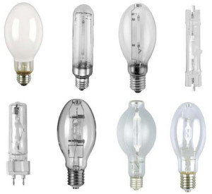
Types of artificial lights
High Intensity Discharge lamps (HID)
Metal halide, mercury vapor, self-ballasted-mercury lamps and high-pressure-sodium lamps all are high intensity discharge lamps.
These lamps are specially designed with inner glass tubes that include tungsten electrodes with electrical arc. This inner glass tube is filled with both metals and gas.
These lamps produce a large quantity of light compared to the fluorescent and incandescent lamps.
High-intensity-discharge lamps are normally used when high levels of light are required over large areas which include outdoor activity areas, gymnasiums, large public areas, pathways, roadways and parking lots.

Slide 11
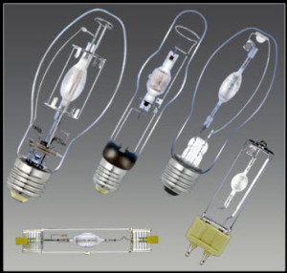
Types of artificial lights
Metal halide lamps
Metal halide lamps consist of a discharge tube or arc tube within a bulb. This tube can be made from either ceramic or quartz and contains mercury, MH salts and a starting gas.
Metal halide lamps produce a great amount of light for their size, and these lamps are one of the most efficient lamps.
These lamps are most commonly used in halls, traffic lights, on stages and in outdoor lighting systems for commercial purposes.

Slide 12
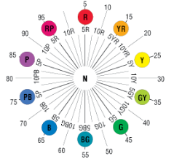
MUNSELL SYSTEM
The Munsell Color Order System is a three-dimensional model based on three colour dimensions: hue, value and chroma.
HUE
HueHue (H) is the actual “color” that follows a natural order of red (R), yellow (Y), green (G), blue (B) and purple (P); designated principle hues.
Between each were intermediate hues yellow-red (YR), green-yellow (GY), blue-green (BG), purple-blue (PB) and red-purple (RP).
Arranged in an equally divided circle, these colors form the Munsell Hue Circle.

Slide 13
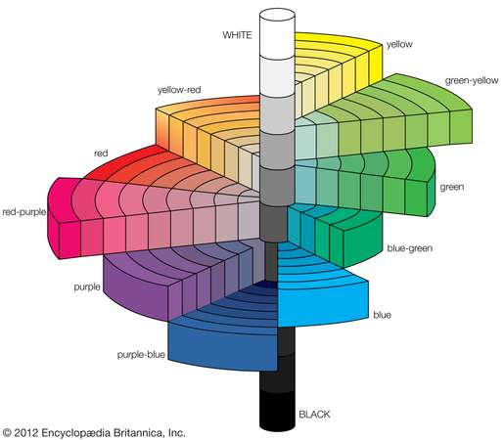
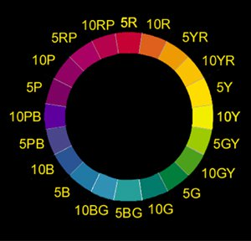
A circle of Munsell colors for a given Munsell value.

Slide 14
MUNSELL SYSTEM
VALUE (Brightness)
ValueValue (V) indicates the lightness of a color.
The scale of value ranges from 0 for pure black to 10 for pure white.
Black, white and the grays between them are called “neutral colors.” They have no hue.
Colors that have a hue are called “chromatic colors.” The value scale applies to chromatic as well as neutral colors.

Slide 15
MUNSELL SYSTEM
CHROMA (Saturation)
Chroma (C) is the degree of departure of a color from the neutral color of the same value.
Colors of low chroma are sometimes called “weak,” while those of high chroma are said to be “highly saturated,” “strong” or “vivid.”
The chroma scale starts at zero, for neutral colors, but there is no arbitrary end to the scale.
The chroma scale for normal reflecting materials extends beyond 20 in some cases. Fluorescent materials may have chromas as high as 30
A color is fully specified by listing the three numbers. For instance a fairly saturated blue of medium lightness would be 5B 5/10 with 5B meaning the color in the middle of the blue hue band, 5/10 meaning medium lightness, and a chroma of 10.

Slide 16
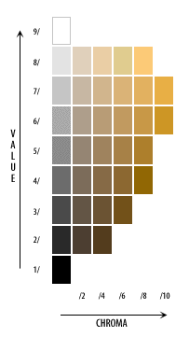
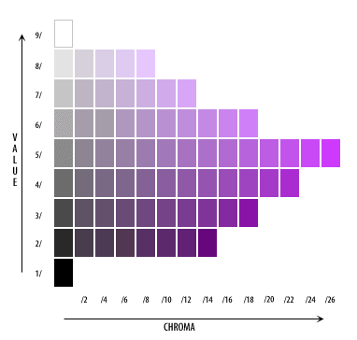

Slide 17
MUNSELL SYSTEM
Advantages: A relatively simple system for comparing colors of objects by assigning them a set of numbers based on standard samples. Widely used in practical applications such as painting and textiles.
Disadvantages: Complementary colors are not on opposite sides, so that one cannot predict the results of color mixing very well.

Slide 18
PHOTOMETRIC MEASUREMENTS
The science of the measurement of light in terms of how the human eye perceives its brightness is known as photometry, which reveals differing sensitivity to different wavelengths of visible light.
Photometric measurements are crucial in the quality control and development of any lighting that is to be utilized in a human environment.
This covers everything from displays such as those found in automobile dashboards and televisions, to the LEDs and generic lighting used in buildings.
Photometric measurements are restricted to the visible spectrum of 380 to 780 nm

Slide 19
PHOTOMETRIC MEASUREMENTS
When measuring, a number of different photometric measurements can be obtained, these include:
Luminous Intensity (I):
It is defined as the quantity of luminous flux emitted within a certain angle in a three dimensional space.
This assesses the source’s divergence and direction.
This measurement is not applicable to collimated light sources and is inaccurate for non-uniform emitters.
The unit of luminous intensity is the candela and is equal to one lumen per steradian.
The detector’s area (or the area prescribed by the aperture in front of it), and its distance from the light source must be knownin in order to calculate luminous intensity.

Slide 20
PHOTOMETRIC MEASUREMENTS
Luminous flux (Φ):
The central quantity used in photometry is luminous flux and this is described as the visible light energy per second radiated by a source.
Unit of Luminous flux is lumens.
It is a measure of a visible light sources whole optical output in all directions.
Recording its measurement requires focusing a source’s full power on a detector.
Luminous Energy:
Luminous energy is defined as the rate of flow of flux and is expressed in lumen-seconds.
Normally, it is applied to pulsed or flashed sources.

Slide 21
PHOTOMETRIC MEASUREMENTS
Luminance (L):
Luminance or photometric brightness is defined as the amount of luminous intensity that passes through a certain area from a certain angle
Luminance has the units of candelas per square meter.
When measuring luminance, the detector field-of-view must be restricted, and its angle calculated.
Illuminance:
Illuminance describes the amount of visible light incident upon a set surface area.
The unit of Illuminance is lumen per square meter which is also known as lux.
Illuminance measurements are prone to errors introduced by off-axis light which must be cosine corrected.

Slide 22
SKY COMPONENT
The light entering a building may be considered as comprising three separate components:
1. Direct sunligh 2. Light from the diffuse sky 3. Diffusely reflected light from the ground and other buildings
Most of the Component usable daylight is from components 2 and 3. Component 2 varies widely between clear sky and clouded conditions. Component 3 may present glare problems due to its low angle, but is probably the most reliable simple solution for tropical and sub-tropical climates.
In the case of light falling on to a point within the building, it can also be broken down into three components:
Sky component (SC)
Externally reflected component (ERC)
Internally reflected component (IRC)

Slide 23
SKY COMPONENT
Basically the light that directly comes from the sky is called sky component or we can say it is ratio of daylight falling on vertical surface to the daylight available under an unobstructed sky.
The sky component normally refers to the diffused sky; i.e. it is not used to describe direct sunlight.
In other words, it can be defined as the ratio of that part of the daylight illuminance at a point on a given plane which is received directly from the sky as compared to the simultaneous exterior illuminance on a horizontal plane from the entire hemisphere of an unobstructed clear design sky.

Slide 24
TOWN PLANNING
Town planning is considered as an art of shaping and guiding the physical growth of the town by creating buildings and enviornments to meet the various needs and to provide healthy conditions to the inhabitants.
Objects of Town Planning
Health – to create and promote healthy conditions and conditions for all the people to live, to work, to play or to relax by proper division of land called zoning.
Convenience – to provide public amenities required for the citizens such as water supply, sanitation, electricity, gas etc.,
Beauty – to preserve the natural conditions and aesthetics in the design of all the elements of the town which includes preservation of trees, natural greenery etc.,

Slide 25
PRINCIPLES OF TOWN PLANNING
1. Zoning
Town is divided into suitable zones such as commercial zone, industrial zone, residential zone etc.,
Suitable rules and regulations are imposed for the development of each zones
2. Housing
Extreme care should be taken to provide housing to various categories of people
Development of slums should be avoided
Exsisting slums should be cleared by providing suitable alternative arrangement

Slide 26
PRINCIPLES OF TOWN PLANNING
3. Public Building
There should be proper balance in grouping and distribution of various public buildings throughout the town
Concentration of public buildings at certain places only should be avoided
4. Recreation Centres
Enough space should be reserved for the development of recreation centres for the general public

Slide 27
PRINCIPLES OF TOWN PLANNING
5. Road System
The efficiency of town is measured by the layout of its roads.
The town should have well designed road systems
6. Transport Facilities
The town should be provided with suitable transport facilities so that there is minimum loss of time for travelling from place to place
7. Green Belt
The growth of town should be such that there is provision of green belt, which is an open strip of land all round the town reserved for special purposes such as cultivation of vegetables, fruits, farm industries etc.,

Slide 28
SLUMS
A slum is an overcrowded, poverty stricken area where there is high rate of birth, infant mortality rate, illiteracy, juvenile crimes, death etc., thus representing a state of hell and therefore unhealthy, unsafe, and socially undesirable
They lack basic amenities like water supply, electricity, drainage etc., and are totally unfit for human habitation

Slide 29
CAUSES OF SLUMS
Lack of education: if the inhabitants are lacking education, then they can be easily dragged into social evils without having any attention to improve their living conditions.
Improper use of land: if the lands that are fit for residential purpose are used for industries, then there will be shortage of land and this can lead to the formation of slums.
Lack of zoning: if the town is not divided into suitable zones and the development is allowed to take place at random, then slums may be formed.
Economic Conditions: the increased growth of population and unemployment may force the affected persons to stay even in unhealthy atmosphere as they offer cheaper living conditions

Slide 30
CAUSES OF SLUMS
Industrialization: the slums may be said to be the direct evil result from industrialization which in the early stages never took care of planning houses for labourers.
Local Authority: if the concerned local authority does not possess adequate powers to control the development of towns, slums may be formed.
Migration: due to uncontrolled migration from surrounding areas, slums may be formed.

Slide 31
CHARACTERISTICS OF SLUMS
Appearance: in slums structures appears to be deteriorated, damaged and overaged which offers an unpleasant view to the eyes
Health & Sanitation: slums are characterised by very low standards of sanitation, high rate of sickness and death rates
Income: slums are usually occupied by lowest income group of the society
Morals: the socially disorganized slumm amy prove to be an area of delinquency and crime
Overcrowding: slums are over croweded with buildings and buildings aree overcrowded with people.
Social Isolation: slums are occupied by people with lowest social status and thus are usually isolated from the society

Slide 32
EFFECT OF SLUMS
Health: climate of slums easily leads to unhealthy living conditions – thus people in slums are easily attacked by various types of diseases
Surrounding Locality: institutions located nearby the slums are also usually badly affected
Working conditions: slums are full of noise, traffic congestion, smoke, dust and darkness, thus they does not provide a peaceful working atmosphere
Absence of Amenities: the surrounding area of slums lack essential amenities because of over crowding of population

Slide 33
SLUM CLEARANCE
The process of improving the existing conditions of slums is known as the slum clearance.
Methods of Slum Clearance are:
1. Improvement Method
2. Complete Removal Method

Slide 34
SLUM CLEARANCE
1. Improvement Method
In this method, the drainage arrangements, public utility services are modified and improved.
Low portions of the old slums are filled up and the existing roads are widened.
Thus with proper planning and implementation of improvement works, it is possible to make slums slightly more habitable at the minimum cost.
This method do not cause much disturbance to the slum dwellers.

Slide 35
SLUM CLEARANCE
2. Complete Removal Method
In this method, congested area may be completely cleared out of the existing locality
Only those buildings which are really good in condition are retained and all other structures are pulled down
Transit camps in the form of temporary buildings are constructed near the slum to accomodate dishoused people during the process of slum clearance

